Slide 1
Lecture 24: Bode Plots 1
Introduction to Feedback Control Systems
Section D (Johnson)
Fall 2016

Slide 2
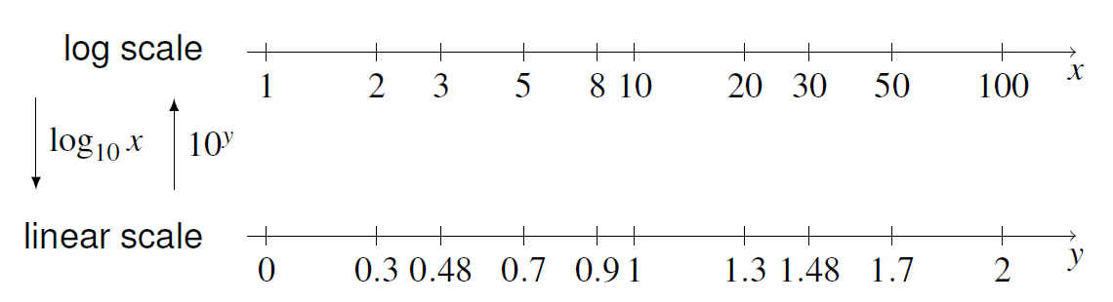
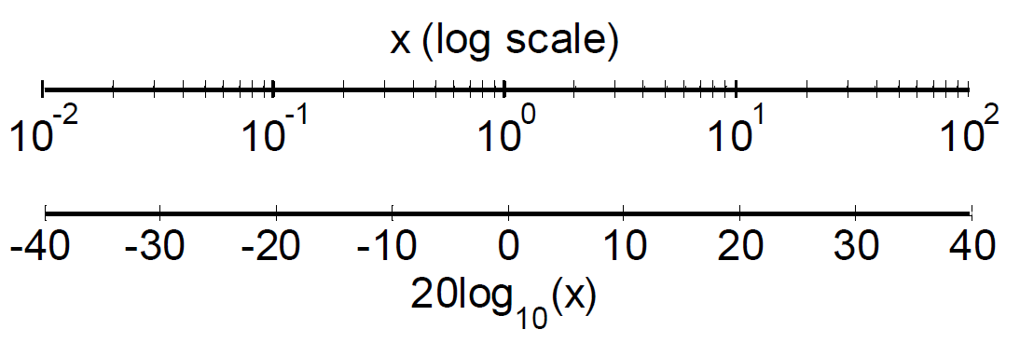
Log vs. linear scales
Basic log scale:
In control systems, we use 20 log₁₀x (dB)

Slide 3
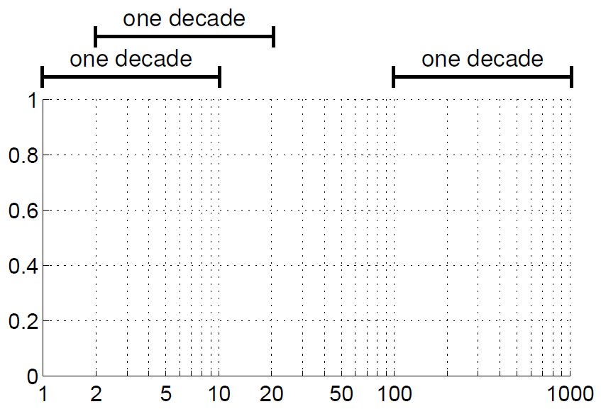
Log scale plot

Slide 4
Ungraded clicker quiz: Sin. steady state & Bode
Recall from the sinusoidal steady state lecture that for a system with transfer function G(s), the steady state output in response to a sinusoidal input u(t) is given by y_{ss}(t):
If u(t) = cos(3t+θ), which of the points in the Bode plots at right are used to find |G(j3)| and ∠G(j3)?
A and C
A and D
B and C
B and D
None of these combinations
A
B
C
D

Slide 5
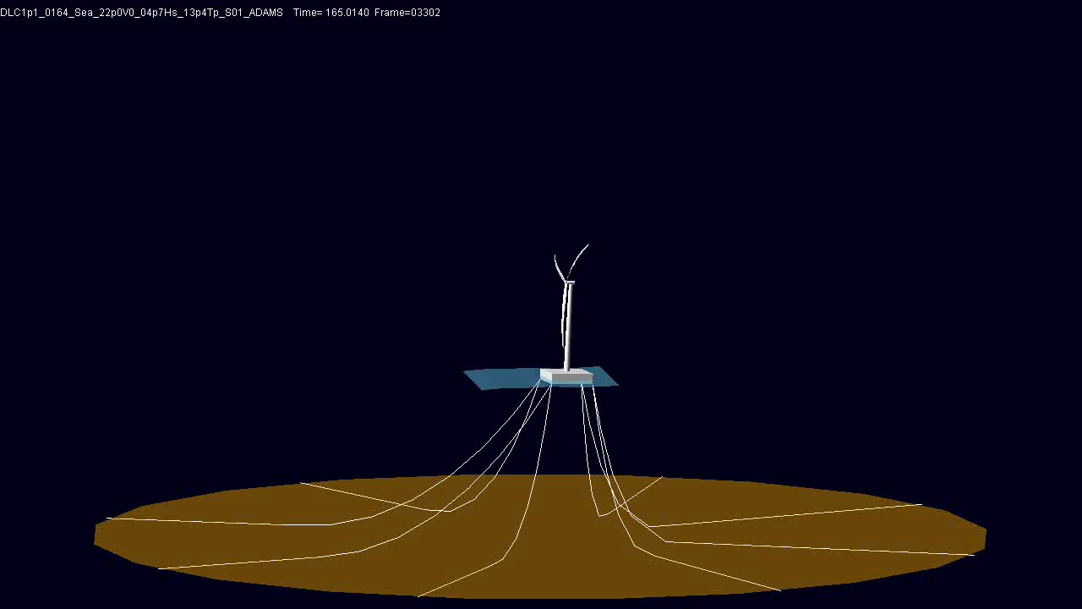

Quote of the Day (Revisited)
Video courtesy of Jason Jonkman, National Renewable Energy Laboratory, 2007

Slide 6
Floating Wind Turbine Interpretation
If the wind turbine is the “system” in the video, name
One or more possible input signals that may be sinusoidal
One or more possible output signals that may be sinusoidal
How might the magnitude Bode plot from wave height to angular position for the floating wind turbine look? Think about how you saw the wind turbine move at different times in the movie and consider low, medium, and high frequency waves.
Hint: you may want to draw a sketch of the floating barge and consider its angle when the wavelength is much larger than the barge, about the same as the size of the barge, or much smaller than the size of the barge.

